Slide 1
Databases and the Web IS53064A
Lecture 2.2
Storing Passwords Securely

Slide 2
Requirement

Slide 3
The Requirement
Many web apps allow users to log in
Every log in requires a password
These passwords need to be stored somewhere
Where?
Usually the database!

Slide 4
Approaches for Storing Passwords

Slide 5
Passwords as plain text
Is this a good approach?
username | password
jdepp | oohaar
wsmith | slapman234
sbullock | speed3
ajolie | byebyebrad
…

Slide 6

Passwords as plain text: Problems
Is this a good approach?
username | password
jdepp | oohaar
wsmith | slapman234
sbullock | speed3
ajolie | byebyebrad
…
Not a good approach. If a hacker gets access to your database, they get all your customer’s passwords!
This not only compromises your site, but other sites (people reuse passwords).

Slide 7
Encrypting passwords
Use a key to encrypt passwords
username | password
jdepp | 9m5CDF$n9JP7Hqj@
wsmith | ZIUYZyRLFjzub@3#
sbullock | $L6JjclJTBvfeiBI
ajolie | Or?39NsXb74BTj!4
…
When user logs in, we can decrypt the stored password to check it
Better?

Slide 8


Encrypting passwords: Problems
Use a key to encrypt passwords
username | password
jdepp | 9m5CDF$n9JP7Hqj@
wsmith | ZIUYZyRLFjzub@3#
sbullock | $L6JjclJTBvfeiBI
ajolie | Or?39NsXb74BTj!4
…
Better than plain text but encryption is reversible
If a hacker gets your key, they get all the passwords
Keys will be stored somewhere, so hacker will be able to find them!
ooharr
encryption
9m5CDF$n9JP7Hqj@
9m5CDF$n9JP7Hqj@
de-encryption
oohaar

Slide 9
Hashing
Don’t store passwords. Store a hash!
oohaar
hash function
6a0e846b3d1bb8569dc3662a139a6e3980d5401a
username | password
jdepp | 6a0e846b3d1bb8569dc3662a139a6e3980d5401a
wsmith | 21e97a7fec2ad1047fe4cea0c48177f800182024
sbullock | 3ef38fd68700909b13c7384fee0080f5e5dfa49f
ajolie | c64f079c7eb58134e860e7d056ef46ab384041e8
…

Slide 10
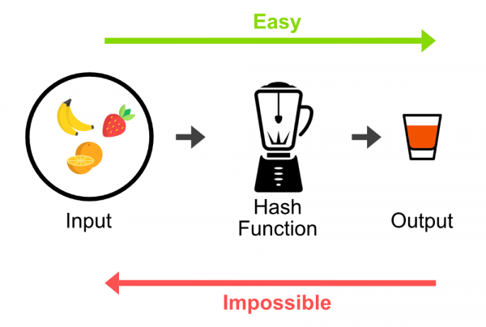
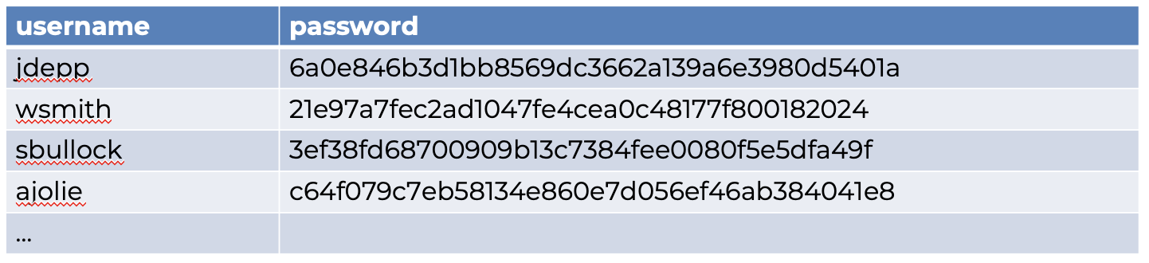
Hashing
Hashes can’t be reversed (one-way function). So for a hacker, getting access to the database is not so useful:
55cf06453b0aeff060b23918ed136cebbec70d4c
?
When a user logs in, we apply the same hash function and compare with the hash stored in the database
username
jdepp
password
oohaar
oohaar
hash function
6a0e846b3d1bb8569dc3662a139a6e3980d5401a
match!

Slide 11
Hashing: Problems
Dictionary attacks
Generate hashes from common passwords and dictionary words.
Password | Hash
password | 5baa61e4c9b93f3f0682250b6cf8331b7ee68fd8
p@ssw0rd | 57b2ad99044d337197c0c39fd3823568ff81e48a
qwerty | b1b3773a05c0ed0176787a4f1574ff0075f7521e
123456 | 7c4a8d09ca3762af61e59520943dc26494f8941b
…
These are called rainbow tables

Slide 12

Hashing: Problems
Dictionary attacks
Generate hashes from common passwords and dictionary words.
Password | Hash
password | 5baa61e4c9b93f3f0682250b6cf8331b7ee68fd8
p@ssw0rd | 57b2ad99044d337197c0c39fd3823568ff81e48a
qwerty | b1b3773a05c0ed0176787a4f1574ff0075f7521e
123456 | 7c4a8d09ca3762af61e59520943dc26494f8941b
…
These are called rainbow tables
With a rainbow table we can find passwords in a database that match.
username | password
ltruss | 55cf06453b0aeff060b23918ed136cebbec70d4c
vputin | e2a09de3428d47f437b413a2528279c0120b7812
dtrump | 5baa61e4c9b93f3f0682250b6cf8331b7ee68fd8
emacron | fc7bf8e3c68c2c1f8da9b53bfa62e7ff9ffb10f3

Slide 13
Hashing and salting
Add an extra string at the end of the password before hashing.
The hash value will be unique even if users have the same (stupid) password
We need to record the salt used in the database:
password
hash function
5baa61e4c9b93f3f0682250b6cf8331b7ee68fd8
password43ka92
hash function
54ee6b0787933c0260f3cfc7eaceff5b6f20de31
passwordj82£hs
hash function
b98a7ee79e23d7ad1dfdbbcc0247f0b5af5c5e78
username | password | salt
ltruss | 55cf06453b0aeff060b23918ed136cebbec70d4c | w53hd2
vputin | e2a09de3428d47f437b413a2528279c0120b7812 | R4%sdd
dtrump | b98a7ee79e23d7ad1dfdbbcc0247f0b5af5c5e78 | 43ka92
emacron | fc7bf8e3c68c2c1f8da9b53bfa62e7ff9ffb10f3 | E$gr4d
Rainbow tables no good here!

Slide 14
Hashing and salting: Problems
With modern hardware, it’s still possible to use a brute force attack, trying the common passwords with the salt stored in the database.
password + w53hd2 → ddf7da9d152c5264496adab574e306ac56c7c456
p@ssw0rd + w53hd2 → 6e5f8befd5a6e2594c0b1949ab2b3c3904bd92d8
qwerty + w53hd2 → 3def95ca9b4c9a88c7a7881bee96826a0b95a947
gotcha!
username | password | salt
ltruss | 3def95ca9b4c9a88c7a7881bee96826a0b95a947 | w53hd2
vputin | e2a09de3428d47f437b413a2528279c0120b7812 | R4%sdd
dtrump | b98a7ee79e23d7ad1dfdbbcc0247f0b5af5c5e78 | 43ka92
emacron | fc7bf8e3c68c2c1f8da9b53bfa62e7ff9ffb10f3 | E$gr4d

Slide 15
Hash + pepper
Less common
Do some research!

Slide 16

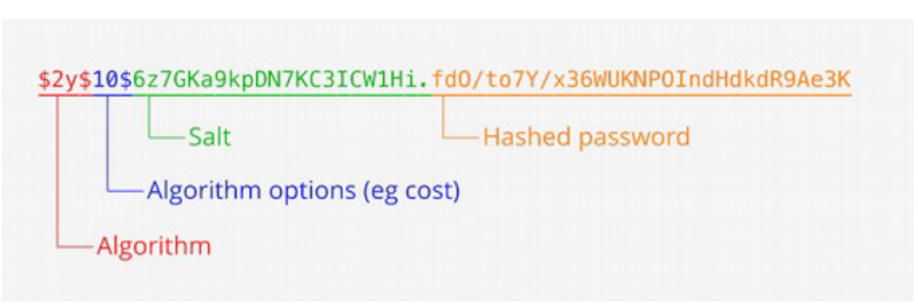
bcrypt
Design to be slow!
Will take ages to generate a long dictionary
Do some reading if you want to understand more:
https://auth0.com/blog/hashing-in-action-understanding-bcrypt/

Slide 17
Summary
Less secure
Plain text
Encryption
Hashing
Salt + Hash
Bcrypt
More secure

Slide 18
Try this out

Slide 19
Have a play
Hashing demo
http://www.dr-chuck.com/sha1.php
Note: SHA1 is not suitable for production websites these days, but still OK for learning purposes

Slide 20
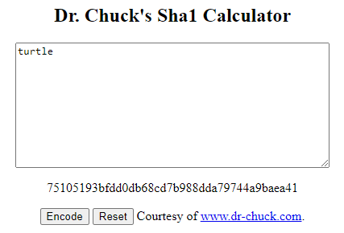
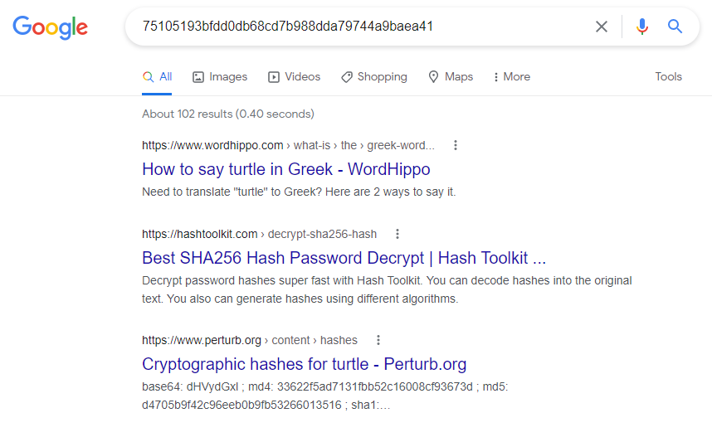
Googling a hash
Choose a common word, e.g.
Google the hash:

Slide 21
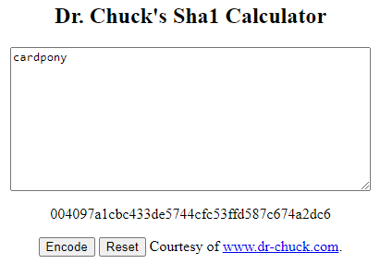
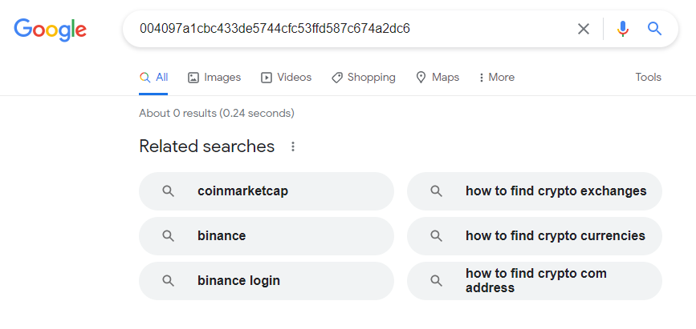
Googling a hash
Try an unusual combination of 2 common words, e.g.
The google it:

Slide 22
Try this in your linux terminal
$ echo -n baseball | sha1sum
a2c901c8c6dea98958c219f6f2d038c44dc5d362

Slide 23
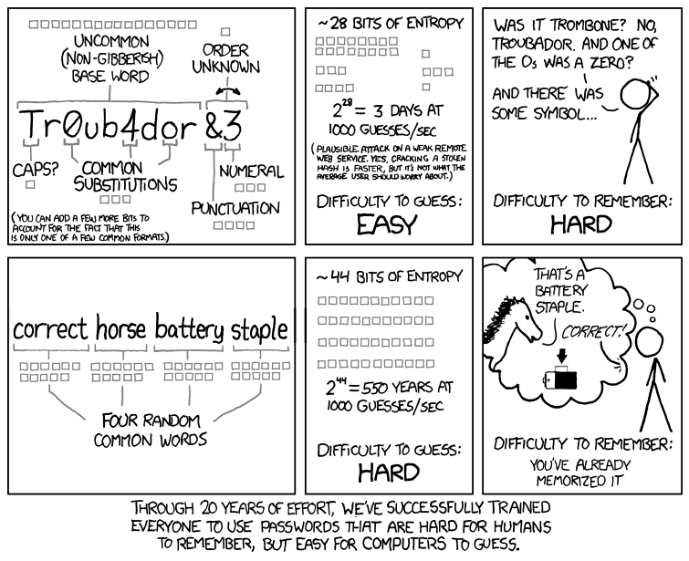
xkcd
Read the explanation here
https://www.explainxkcd.com/wiki/index.php/936:_Password_Strength

Slide 24
This hash or that hash!
It should be noted that the hash functions used to protect passwords are not the same as the hash functions you may have seen in a data structures module.
The hash functions used to implement data structures such as hash tables are designed to be fast, not secure.
Only cryptographic hash functions should be used to implement password hashing.
Hash functions like SHA256, SHA512, RipeMD, and WHIRLPOOL are cryptographic hash functions.

Slide 25
Node.js

Slide 26
In the lab next week…
Install bycrypt
$ npm install bcrypt
Use it

Slide 27
In the lab next week…
Working with our bookshop app:
We will register users with a password
We will ask users to log in
We will use bcrypt to do this all in a secure manner!

Slide 28
Something to think about…
In DWA, we created code like this:
// Define the database connection
const db = mysql.createConnection ({
host: 'localhost',
user: 'root',
password: ‘fh7^hdj32',
database: 'myBookshop'
});
Any issues?
Can we do better?

Slide 29
End of slides

